Slide 1
Introduction to Control Systems

Slide 2
Classification of Control System
Classification of Control System
Analog Control (unit:1-4)
Digital Control
Open Loop
Control System
Closed Loop Control System
Open Loop
Control System
Speed Control
position control
2

Slide 3
Open Loop Control Systems
A system in which the output has no effect on the control action is known as an open loop control system.
For a given input the system produces a certain output

Slide 4

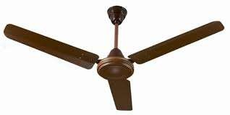
Open Loop Control System
A Fan with blades and with regulator is a open loop “CONTROL SYSTEM”
Desired Reference
Regulator (controller)
Control Input
Plant(Fan)
Control Element
Input
Output
230V/50Hz
Controlled Airflow
AC Supply
(Desired Output)
4

Slide 5
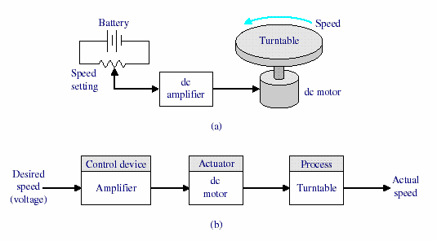
Open Loop control System

Slide 6
Examples of Open Loop Control Systems
We use open loop control systems in many applications of our day to day life. Some of the systems designed based on the concept of open loop control systems.
Automatic washing machine.
Electric hand drier.
Time-based Bread toaster.
Automatic coffee Vending Machine.
TV remote control.
Door lock system.

Slide 7
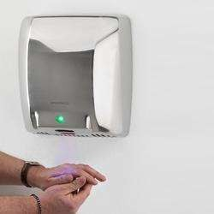
OLCS Examples
Electric hand drier – Hot air (output) comes out as long as you keep your hand under the machine, irrespective of how much your hand is dried.
7

Slide 8
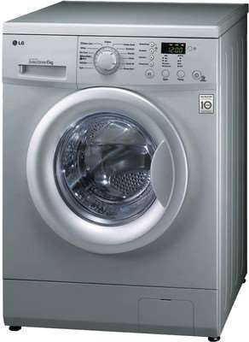
OLCS Examples
Automatic washing machine
This machine runs according to the pre-set time irrespective of washing is completed or not.
8

Slide 9
Open Loop Control System Example
A traffic control system is a good example of an open loop system. The signals change according to a preset time and are not affected by the density of traffic on any road.

Slide 10
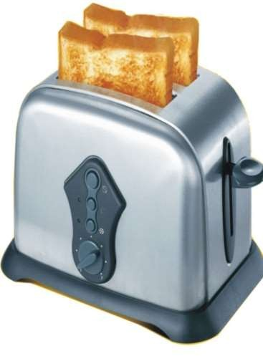
OLCS Examples
Bread toaster
This machine runs as per adjusted time irrespective of toasting is completed or not.
10

Slide 11
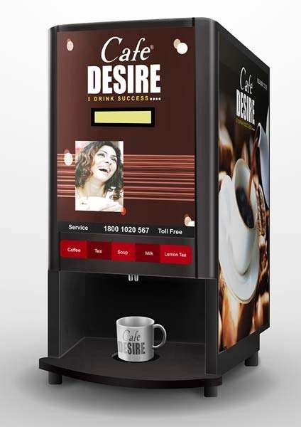
OLCS Examples
Automatic tea/coffee Vending Machine – These machines also function for pre adjusted time only.
11

Slide 12
Tank level control
An example of a manual open loop control system. In open loop control system when we start the pump it will continue fill the fluid in the tank but at a time tank will overflow still pump will not stop.
Hi level switch
Start/stop
lo level switch

Slide 13
OLCS Examples
Light switch – lamps glow whenever light switch is on irrespective of light is required or not.
Volume on stereo system – Volume is adjusted manually irrespective of output volume level.
13

Slide 14
Advantages of OLCS
Simple in construction and design.
Economical.
Easy to maintain.
Generally stable.
Convenient to use as output is difficult to measure.
14

Slide 15
Disadvantages of OLCS
They are unreliable
They are inaccurate
Any change in output cannot be corrected automatically.
If there are any disturbances, the out put changes and there is no adjustment of the input to bring back the output to the original value.
15

Slide 16
Closed Loop System
Definition:
A system in which the control action is some how dependent on the output is called as closed loop system
Input is control by output or input is dependant on output
Negative Feed back is used
16

Slide 17
Classification of Control System
Classification of Control System
Analog Control (unit:1-4)
Digital Control
Open Loop
Control System
Closed Loop Control System
Open Loop
Control System
Speed Control
position control
17

Slide 18
Block Diagram of CLCS
Forward Path
Command
Error Signal
Manipulated
Controlled O/p
I/p
Reference Transducer
Controller
Signal
Plant
r(t)
e(t)
m(t)
c(t)
Reference I/p
Feedback
Transducer
Feedback Signal
b(t)
c(t)
Feedback Path
18

Slide 19
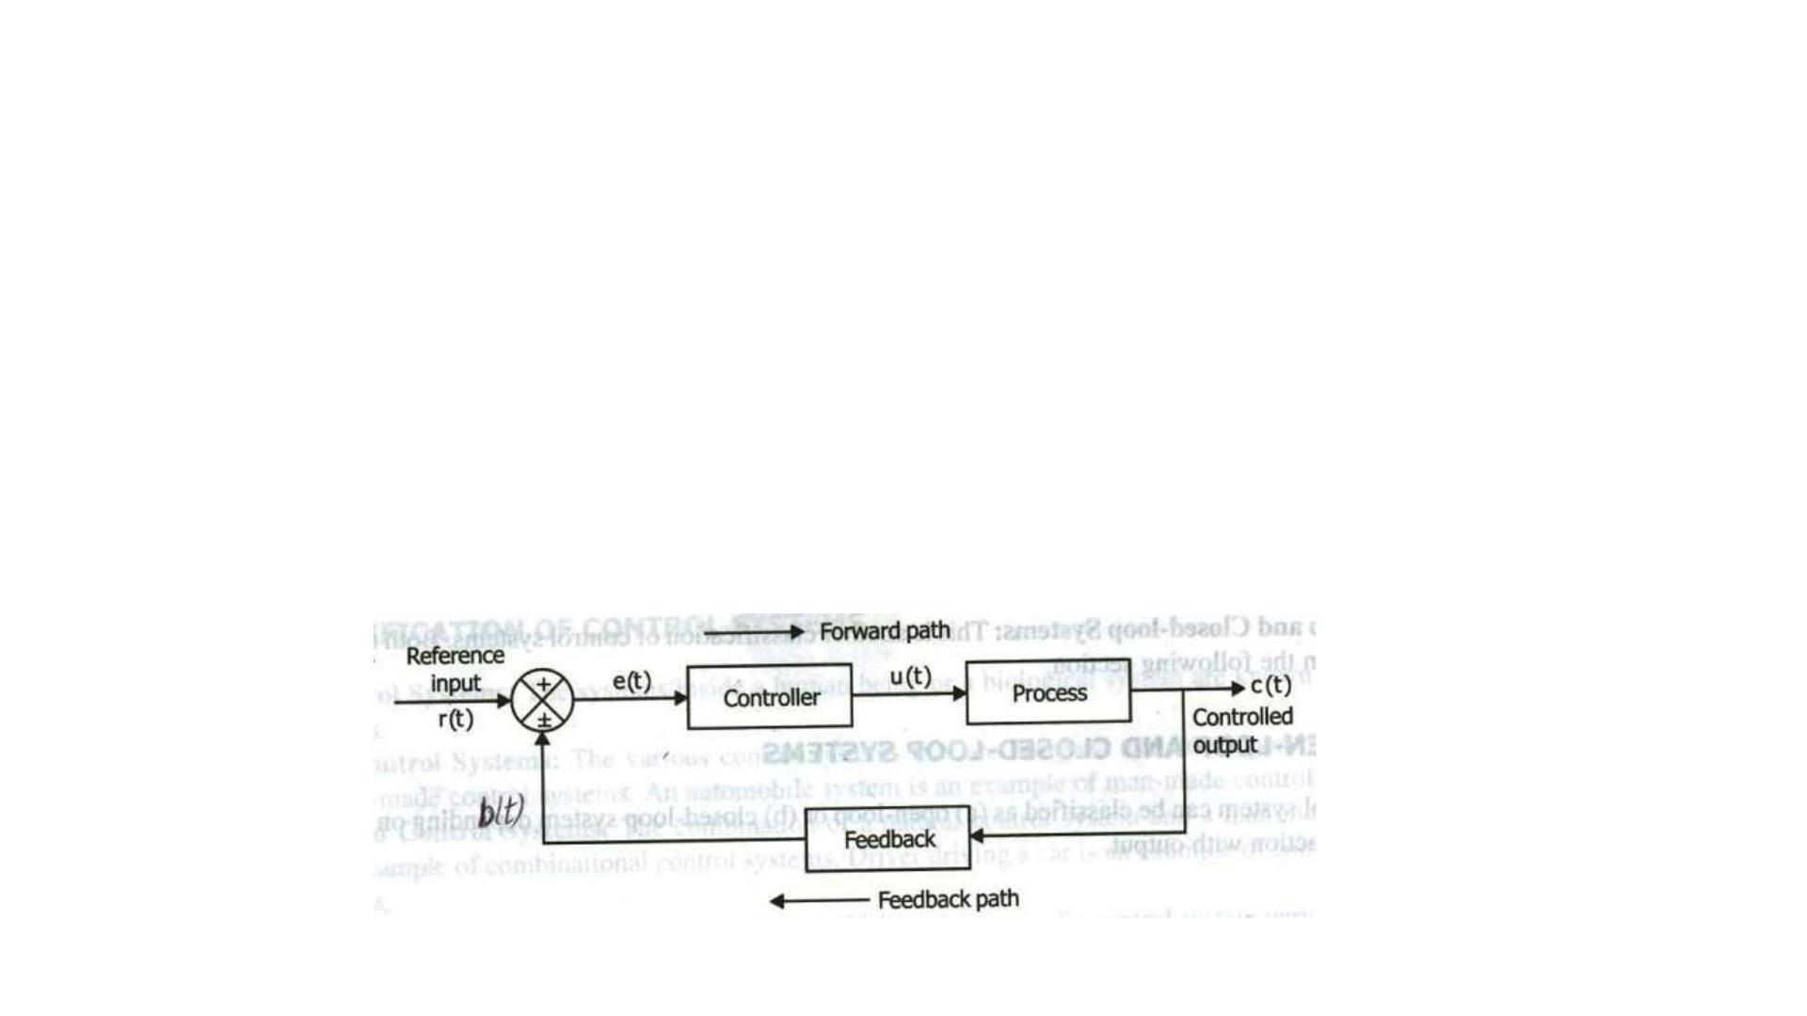
Closed loop control system
A system which maintains a prescribed relationship between the controlled variable(O/P) and the input signal.
The output or the controlled variable is measured and compared with the reference input and an error signal is generated.

Slide 20
Closed loop control system
Controlled variable activating signal to the controller which, by its action, tries to reduce the error.
Thus the controlled variable is continuously feedback and compared with the input signal If the error is reduced to zero, the output is the desired output and is equal to the reference input

Slide 21
Examples of Close Loop Control Systems
Automatic Liquid level control system
Room temperature control system
Human biological system
Air Conditioner
Automatic Electric Iron
Lift system

Slide 22
Examples of Close Loop Control Systems
Voltage stabilizer.
Missile Launcher.
Fire control Radar systems
Inverter AC.
Turbine Water Control System at power Station etc

Slide 23
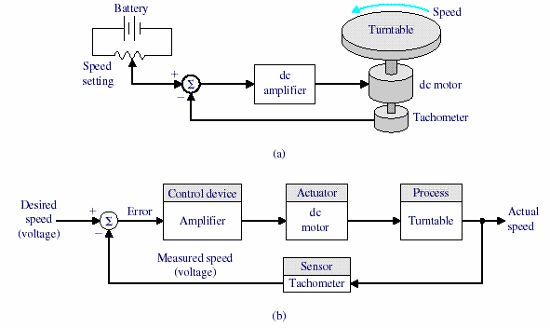
Closed Loop Control Systems( Speed Control)

Slide 24
Basic Components of Closed Loop Control System
Plant
Feedback
Controller
Error detector

Slide 25
Plant:
The portion of a system which is to be controlled or regulated is called as plant or process.
It is a unit where actual processing is performed.
The input of the plant is the controlled signal generated by a controller.
A plant performs necessary actions on a controlled system and produces the desired output. Examples Motor, actuators etc

Slide 26
Feedback:
It is a controlled action in which the output is sampled and a proportional signal is given to the input for automatic correction of any changes in the desired output.
The feedback signal is fed to the error detector. Negative feedback is used as it results in better stability and accuracy. The other disturbance signals are rejected.

Slide 27
Controller:
the element of a system within itself or external to the system which controls the plant is called as a controller. The error signal will be a weak signal and so it has to be amplified and then modified for better control action.
In most of the systems, the controller itself amplifies the error signal and integrates or differentiates to generate a control signal. An amplifier is used to amplify the error signals and the controller modifies the error signal.

Slide 28
Error Detector:
The function of error detector is to compare the reference input with the feedback signal. It produces an error signal which is a difference of two inputs which are reference signal and a feedback signal.
The error signal is fed to the controller for necessary controlled action. This error signal is used to correct the output if there is a deviation from the desired value.

Slide 29
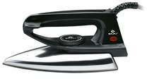
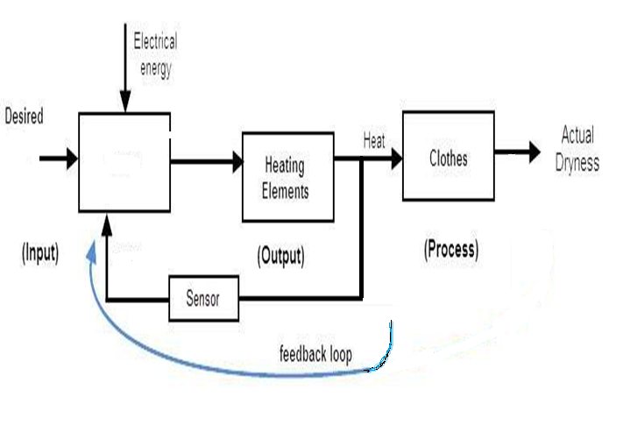
Automatic Electric Iron-Heating elements are controlled by output temperature of the iron.
Temp
Comp

Slide 30
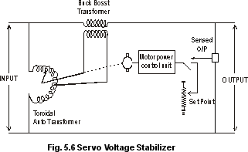
CLCS Examples
Servo voltage stabilizer – Voltage controller operates depending upon output voltage of the system.
30

Slide 31
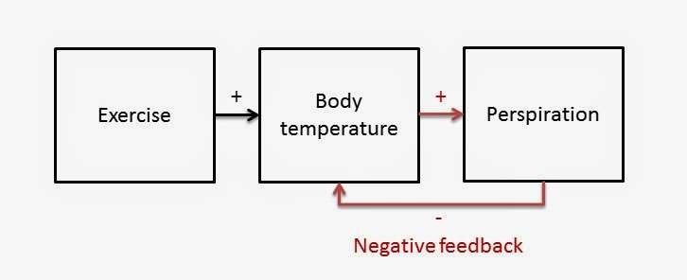
CLCS Examples
Perspiration
31

Slide 32
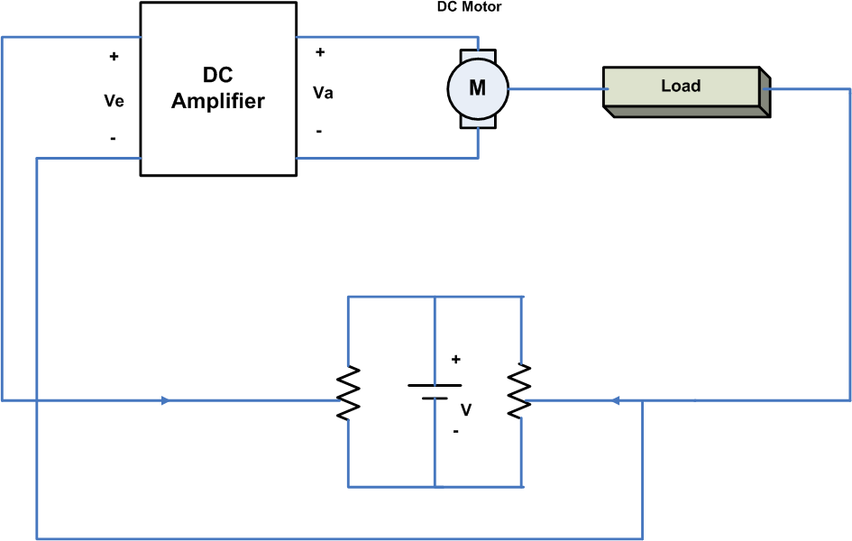
DC Servo System (Position control system)
32

Slide 33

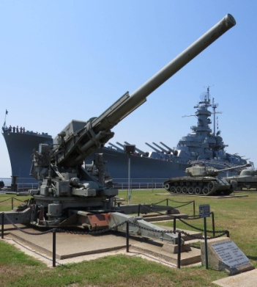
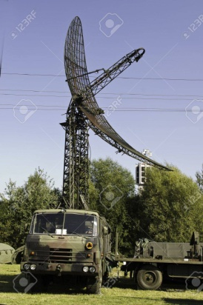
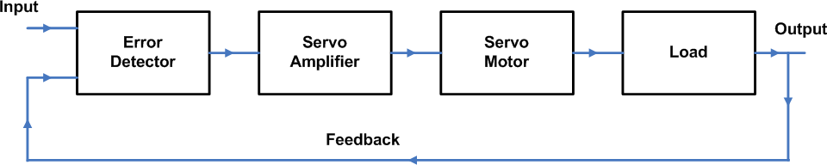
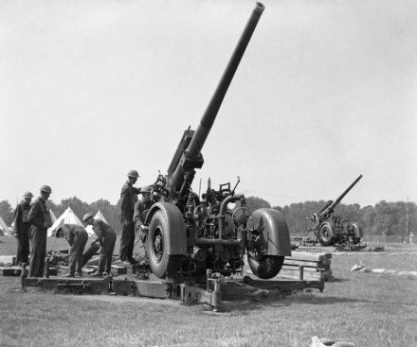
General block diagram of Servo System Radar and Gun control
Radar
Gun
33

Slide 34
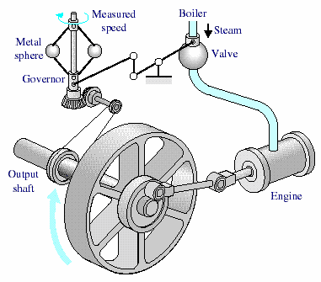
Closed loop system

Slide 35
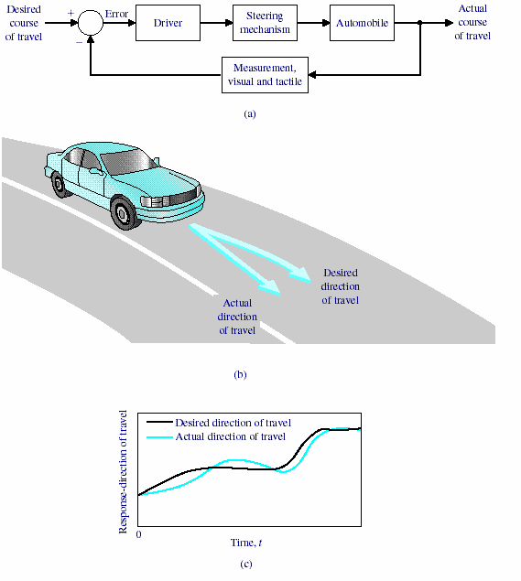
Closed loop system(manual control)

Slide 36
Tank level control
An example of a manual Closed loop control system. In this system when we start the pump it will continue fill the fluid in the tank when tank is filled / empty observed by human who control pump.
Hi level switch
Start/stop
lo level switch

Slide 37
Liquid Level
Closed loop control system have information about the change in process with respect to change in input. Now consider the previous example in open loop control system.
Hi level switch
Start/stop
lo level switch
Control system

Slide 38
Advantages of CLCS
Closed loop control systems are more accurate even in the presence of non-linearity.
Highly accurate as any error arising is corrected due to presence of feedback signal.
Bandwidth range is large.
Facilitates automation.
The sensitivity of system may be made small to make system more stable.
This system is less affected by noise.
38

Slide 39
Disadvantages of CLCS
They are costlier.
They are complicated to design.
Required more maintenance.
Feedback leads to oscillatory response.
Overall gain is reduced due to presence of feedback.
Stability is the major problem and more care is needed to design a stable closed loop system.
39

Slide 40
Difference Between OLCS & CLCS
Open Loop Control System Closed Loop Control System
1. The open loop systems 1. The are simple & economical.
closed loop systems
are complex and costlier
2. They power. |  | consume | less | 2. | They power. |  | consume | more
3. | The OL | systems are |  | 3. | The | CL systems are not
 | easier | to construct |  |  | easy | to construct because
 | because | of less number |  |  | of | more number of
of components required.
components required.
4. The open loop systems are inaccurate &
4. The closed loop are accurate &
systems
more
unreliable
reliable.
40

Slide 41
Difference Between OLCS & CLCS
Open Loop Control System Closed Loop Control System
5. Stability problem systems.
is not a major in OL control
5. Stability is a major problem in closed loop systems & more care is needed to design a stable closed loop system.
Generally OL
systems are stable.
Small bandwidth.
Feedback element is absent.
Output measurement is not necessary.
Large bandwidth.
Feedback element is present.
Output measurement is necessary.
41

Slide 42
Difference Between OLCS & CLCS
Open Loop Control System Closed Loop Control System
9. The changes in the output due to external disturbances are not corrected automatically. So they are more sensitive to noise and other disturbances.
9.The changes in the output due to external disturbances are corrected automatically. So they are less sensitive to noise and other disturbances.
10. Examples:
10. Examples:
Coffee Maker,
Guided Missile,
Automatic Toaster,
Temp control of oven,
Hand Drier.
Servo voltage stabilizer.
42

Slide 43
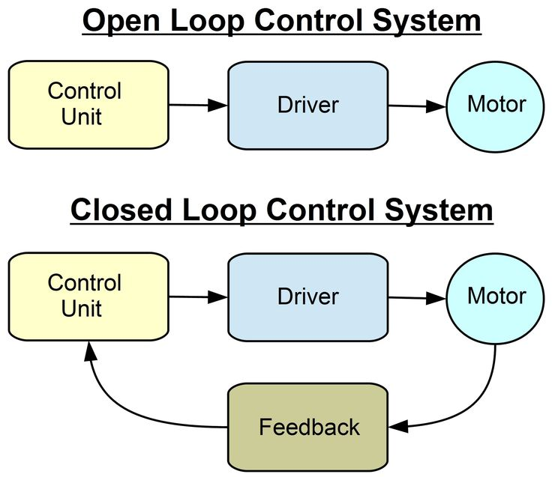
Comparison between open and closed loop

